Slide 1



Utility of differentiable programming and ML frameworks for plasma simulation
Dr Aidan Crilly
Eric and Wendy Schmidt AI in Science Postdoctoral Fellow

Slide 2
Some Observations
Increasing use of simulation ensembles for UQ and optimization
Introducing data to physics-driven models
HPC systems increasing incorporating GPUs into compute
E.g. Archer2 GPU nodes (1x CPU for 4x GPU)

Slide 3
Uses from modern ML frameworks
ML researchers (Google, Meta, NVIDIA, etc.) have built languages/frameworks with the following useful properties:
Automatic differentiation/differentiable programming
Just-in-time compilation/code generation/abstraction - DSL
Native accelerator (GPU, TPU, etc.) support
How can we make use of these in plasma modelling?

Slide 4
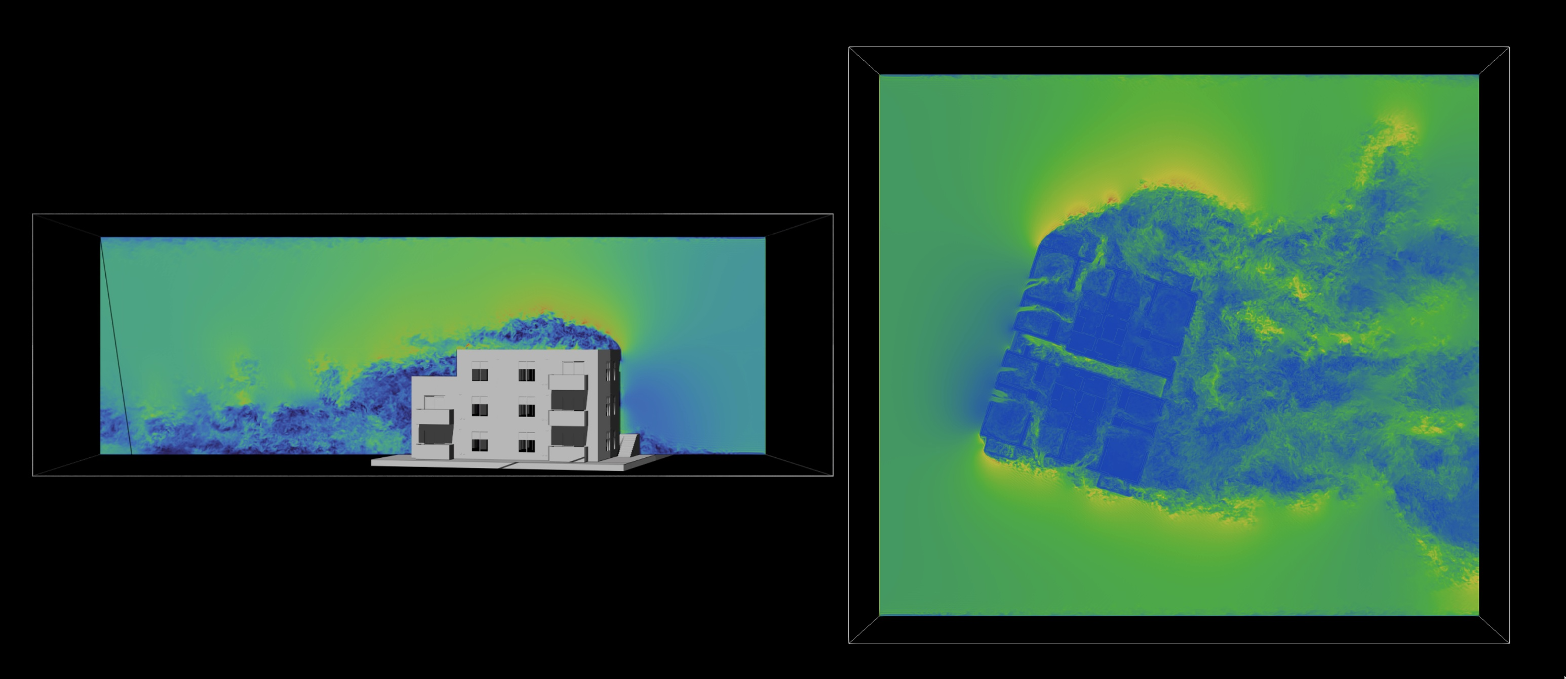
ML frameworks/languages with these capabilities
Julia
GoogleJax
PyTorch
Tensorflow/Keras
Caffe
…
Codes that couple scientific computing and ML in a differentiable way (access to gradients)
Firedrake
Diffrax
Julia SciML

Slide 5
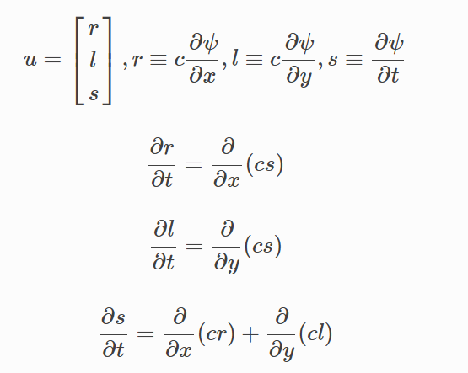
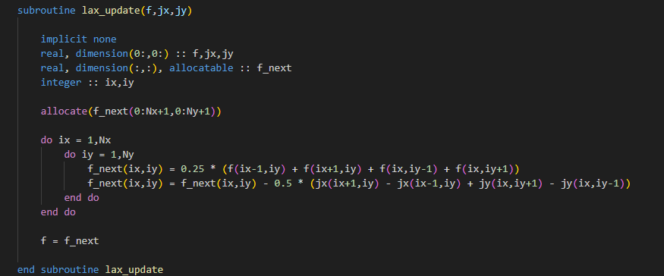
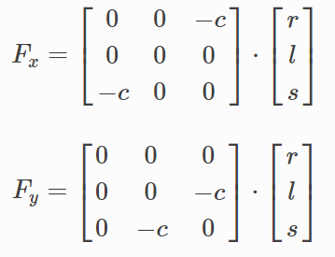
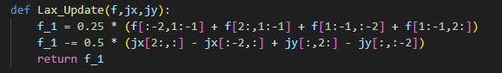
Simple example: Lax method for wave equation
Fortran and JAX source looks pretty similar: e.g.

Slide 6
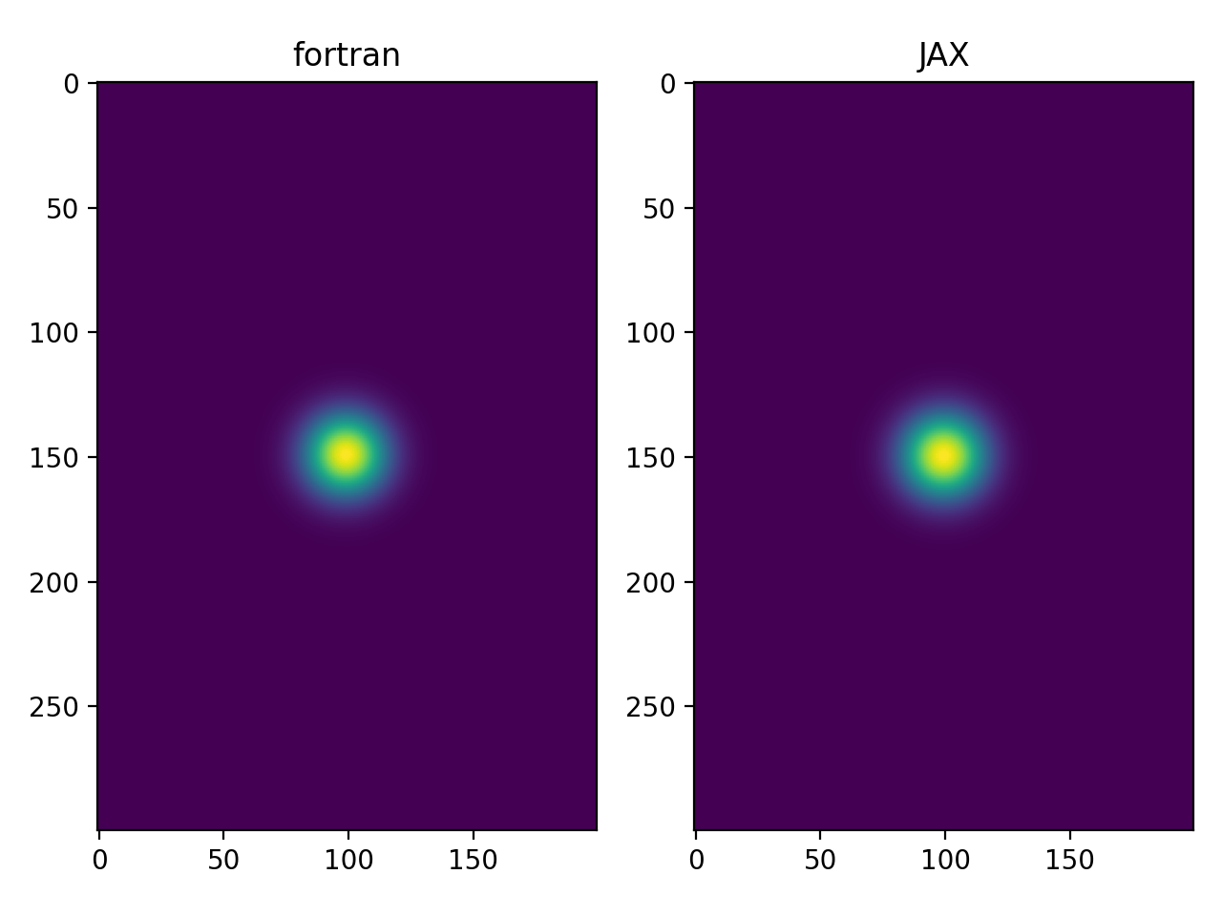
Proof: high level code with JIT is performant
Without I/O:
Runtime in JAX (with JIT compilation): 0.83 s
Runtime in fortran (-O2): 2.49 s
N.B. JAX is natively multi-threaded, fortran requires external library (OpenMP)

Slide 7
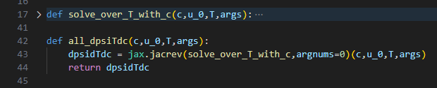
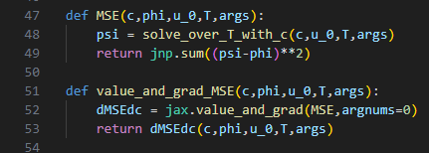
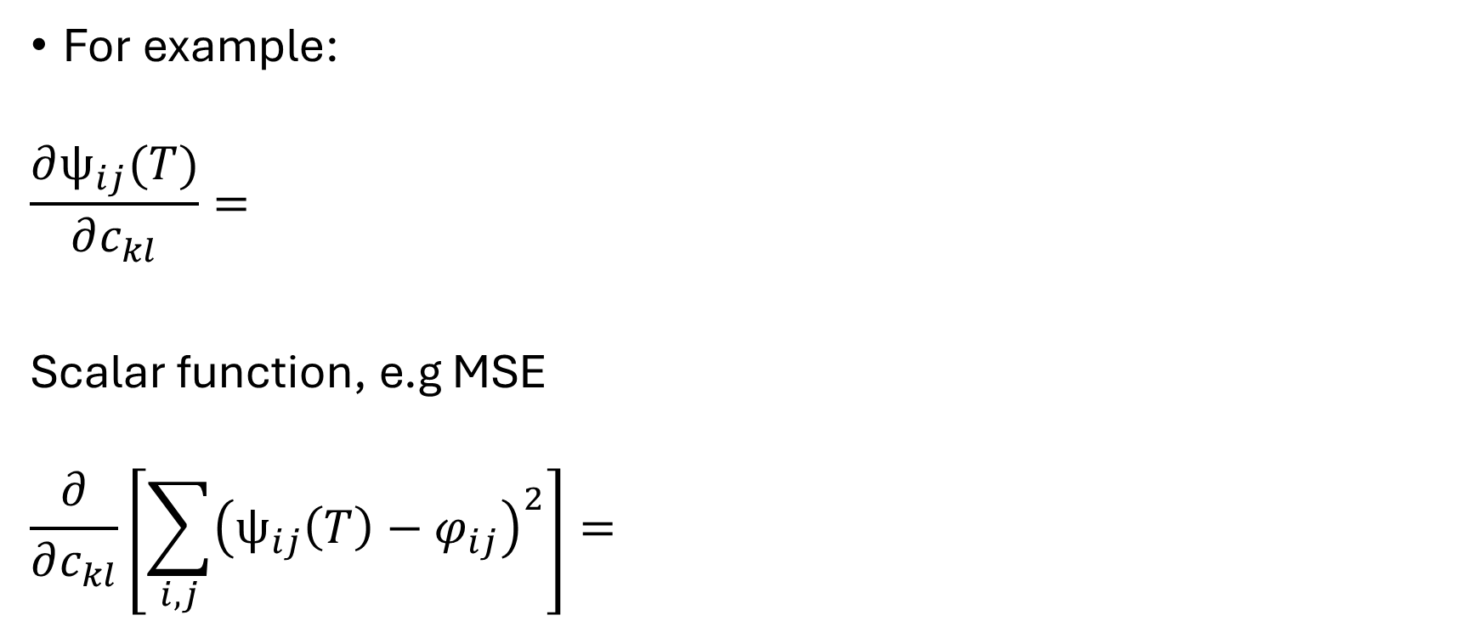
Proof: you can get gradients in few lines
For example:
$$\frac{∂ψ_{ij}(T)}{∂c_{kl}}=$$
Scalar function, e.g MSE
$$\frac{∂}{∂c_{kl}}\left[\sum_{i,j}{{\left(ψ_{ij}\left(T\right)−φ_{ij}\right)}^{2}}\right]=$$
Shape is (Nx,Ny,Nx,Ny)
Shape is (Nx,Ny)

Slide 8
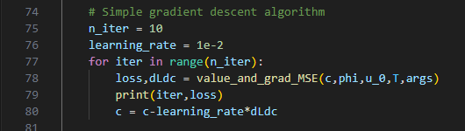
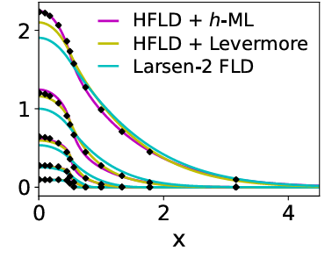
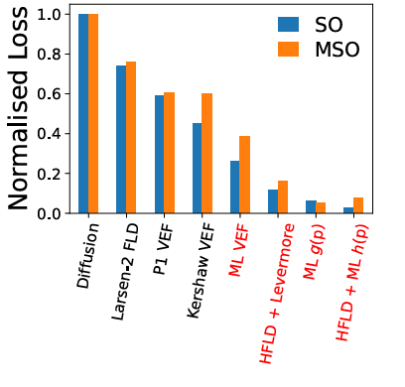

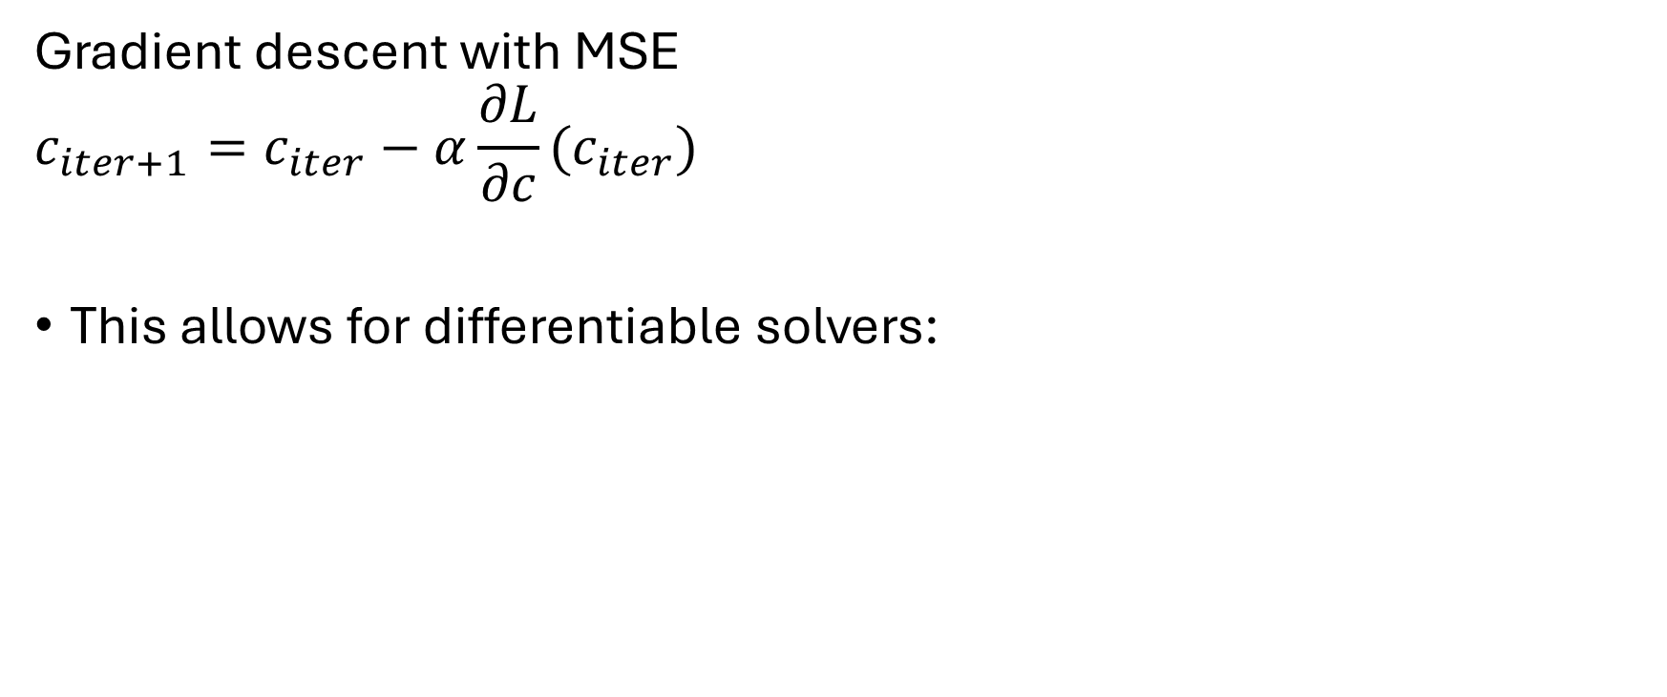
Proof: you can get gradients in few lines
Gradient descent with MSE
$$c_{iter+1}=c_{iter}−α\frac{∂L}{∂c}(c_{iter})$$
This allows for differentiable solvers:
Use case:
Learning closure relations in radiation transport
JQSRT paper:

Slide 9
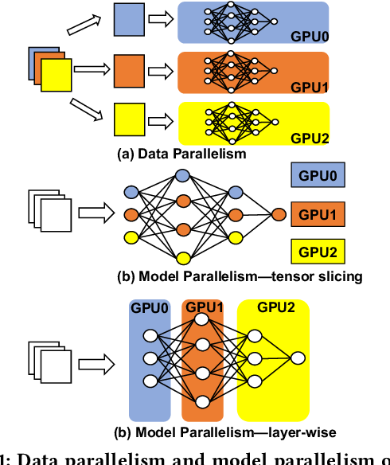
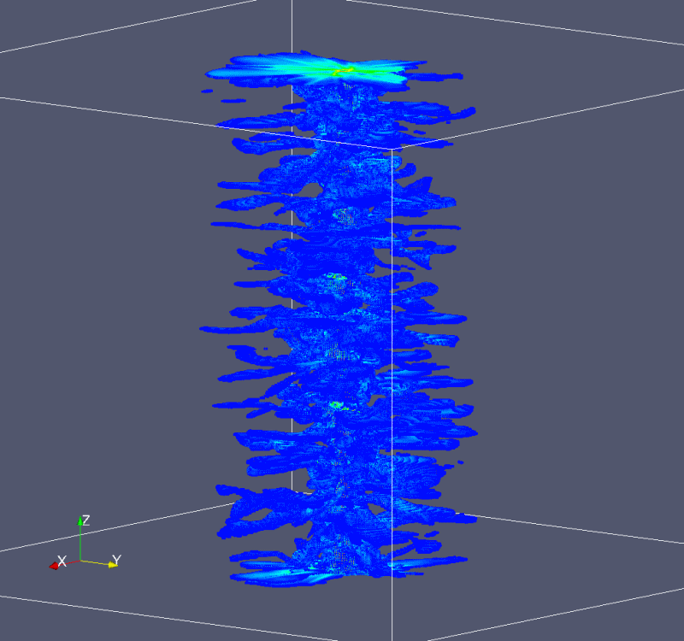
HPC across ML and Scientific Computing

Slide 10
Proof: simple port to GPU
No change to source code – just installing cuda-enabled build
For JAX:
pip install -U "jax[cpu] " becomes pip install -U "jax[cuda12_pip]"
Runtime on cx1 GPU_72 queue for Lax example:
Runtime in cpu JAX: 0.83 s
Runtime in gpu JAX: 0.06 s (!!!)
Runtime in fortran (-O2): 2.49 s
Same story for other ML frameworks
Can see cx1 GPU software stack with module load tools/gpu-headnode

Slide 11
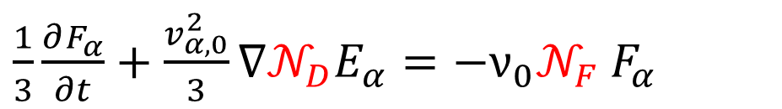
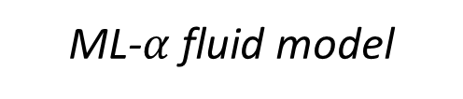
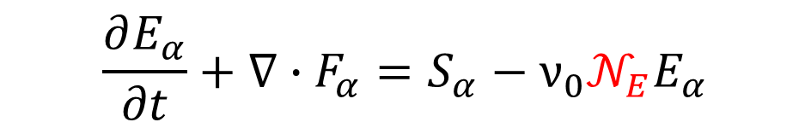
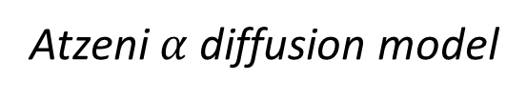


Use case in my research: Fluid model for fusion alphas
DT fusion produces alpha particles at 3.5 MeV
Long mean-free path in plasma leading to non-local behaviour, requires transport
We seek a reduced order model which integrates out velocity space:
ML-$α$ fluid model
Atzeni $α$ diffusion model
$$\frac{∂E_{α}}{∂t}+∇∙F_{α}=S_{α}−ν_{0}𝒩_{E}E_{α}$$
$$\frac{∂E_{α}}{∂t}+∇∙F_{α}=S_{α}−ν_{0}E_{α}$$
$\frac{1}{3}\frac{∂F_{α}}{∂t}+\frac{v_{α,0}^{2}}{3}∇𝒩_{D}E_{α}=−ν_{0}𝒩_{F}$ $F_{α}$
$$F_{α}=−\frac{v_{α,0}^{2}}{3ν_{0}}∇E_{α}$$

Slide 12
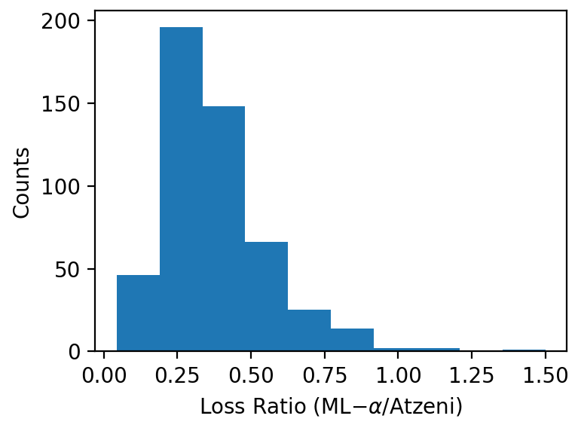
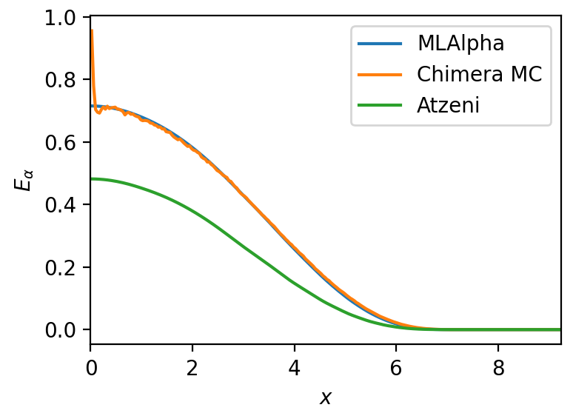
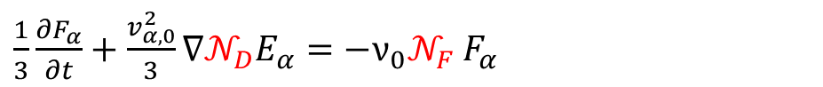

Preliminary results
$$\frac{∂E_{α}}{∂t}+∇∙F_{α}=S_{α}−ν_{0}𝒩_{E}E_{α}$$
$\frac{1}{3}\frac{∂F_{α}}{∂t}+\frac{v_{α,0}^{2}}{3}∇𝒩_{D}E_{α}=−ν_{0}𝒩_{F}$ $F_{α}$
Consistently outperforms Atzeni’s diffusion model
MSE smaller for ML-𝛼 fluid model
“Good” performance – small hydrostatic gradients

